Slide 1
INTRODUCTION TO COMPUTING
FINAL PROJCET
Presentation
Muhammad Uzair Gull (260)
Naveed Hussain (276)
Ali Raza (252)

Slide 2
Tittle:
School Website
Home
About us
Admission
Academic
Blog
School calendar
Contact us

Slide 3
Language Used:
HTML
CSS
JAWASCRIPT

Slide 4
Software Used:
Notepad++
Visual Studio

Slide 5
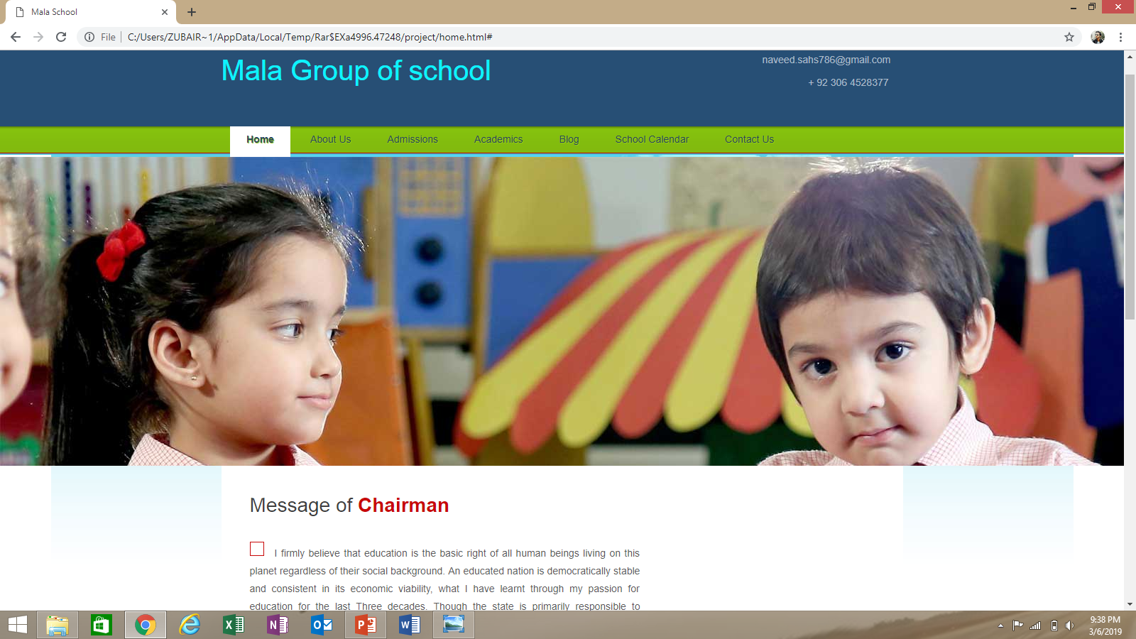
Home
I firmly believe that education is the basic right of all human beings living on this planet regardless of their social background. Education also combats unemployment, confirms sound foundation of social equity, awareness, tolerance and spread of political socialization and cultural vitality.

Slide 6

About us
Mala Group of School was established in 1987 and became a fastest growing educational network and trusted name in providing quality education. Currently, it has Five branches with Eleven campuses, more than 9000 students are enrolled in these branches and hundreds of faculty members are providing their services for educating these students. Alhamdulillah! With the countless blessings of Allah Almighty and the continuous successes of all branches, Mala School has just started a dynamic project i.e. to fulfill the utmost need for widening one’s horizons. Qazi Apex Grammar School is famous for its perennial beauty.

Slide 7
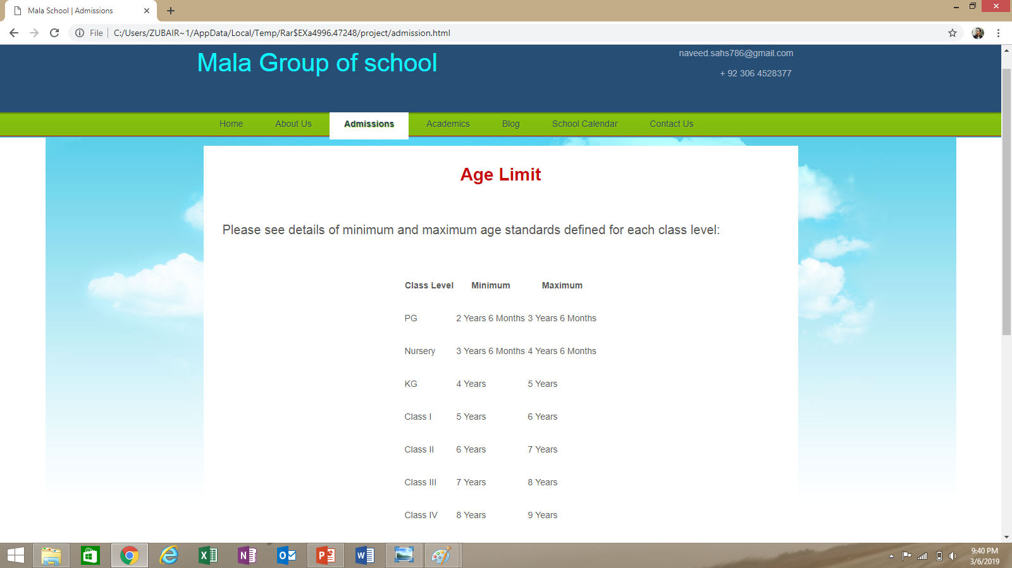
Admission
New user can online Applying easily
Admission Form
Class Level
Age Limit
School website also available on Internet.

Slide 8
Academic
Mala Group of school has integrates teaching, research and creative activities in an engaging, challenging and supportive learning environment to prepare productive citizens for Pakistan and the world. The basis of development of the plan is a set of values which are the fabric of the institution.

Slide 9
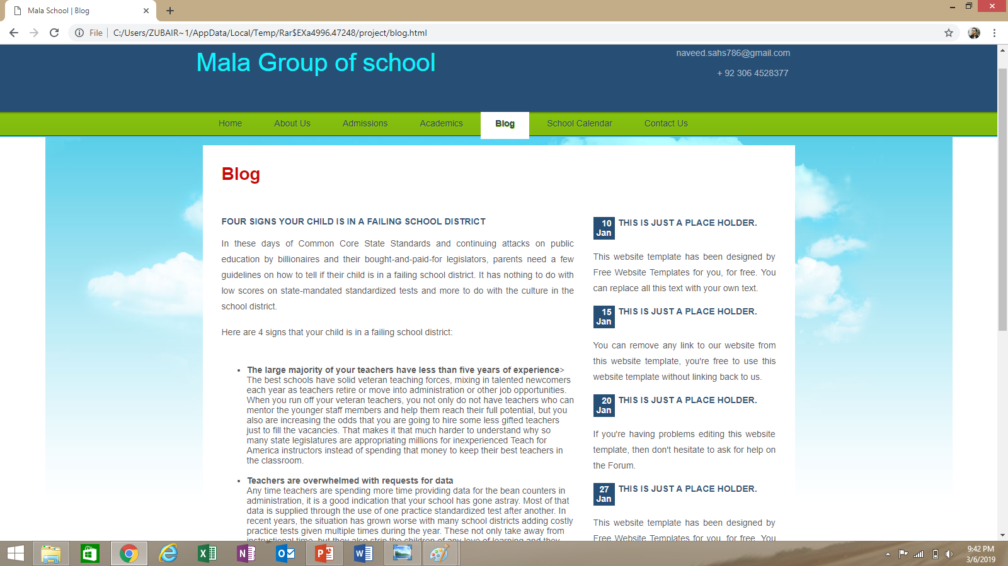
Blog
The large majority of your teachers have less than five years of experience
Teachers are overwhelmed with requests for data
Teachers receive no support from administrators on discipline issues
Professional development is limited to indoctrination and data

Slide 10
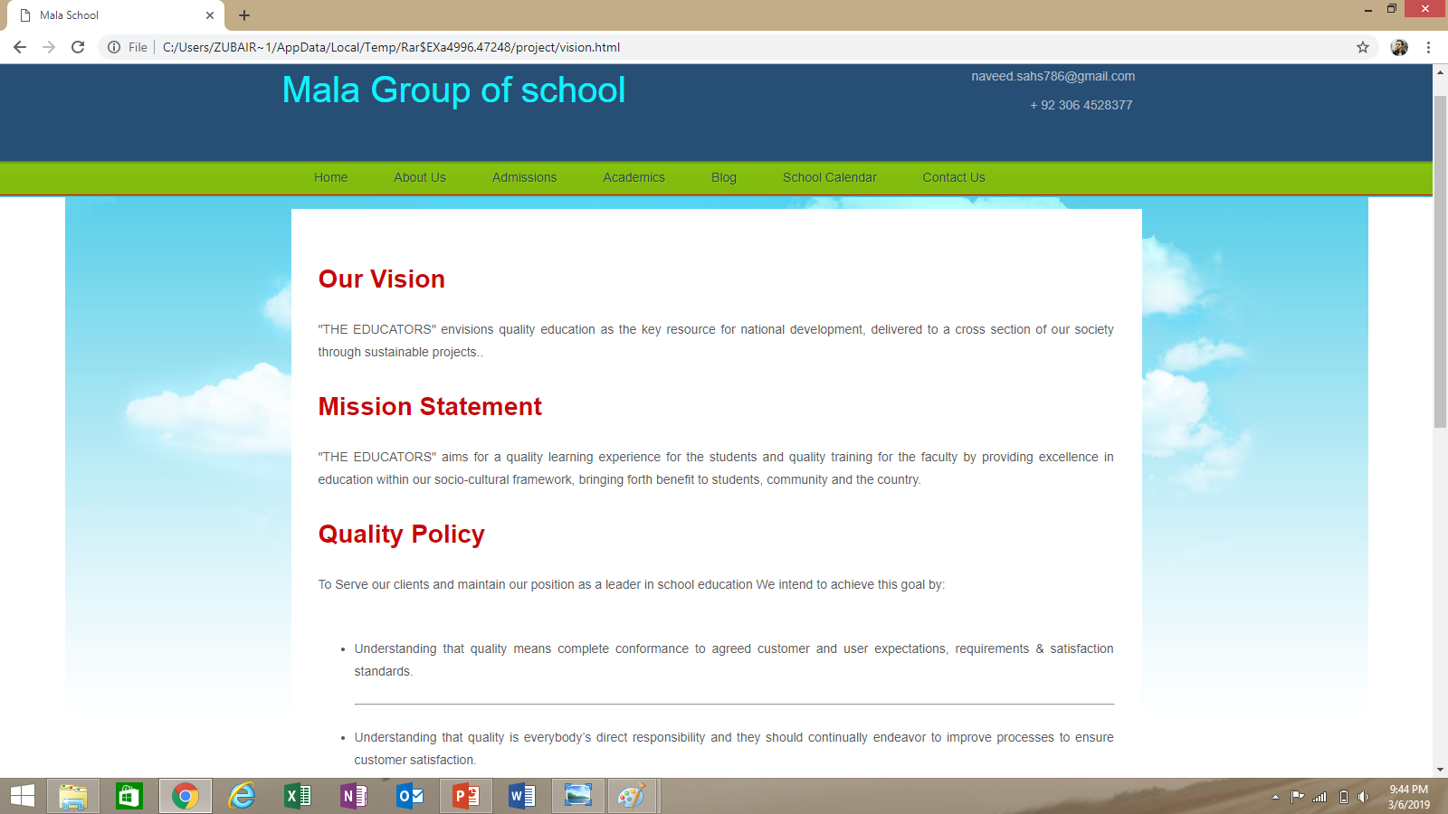
Our Vision
"THE EDUCATORS" envisions quality education as the key resource for national development, delivered to a cross section of our society through sustainable projects.
We exercise high standards for learning, teaching and inquiry.
We demonstrate integrity through honesty, civility and fairness.
We embrace the diversity of individuals, ideas and expressions.
We uphold the responsibility of our students.

Slide 11
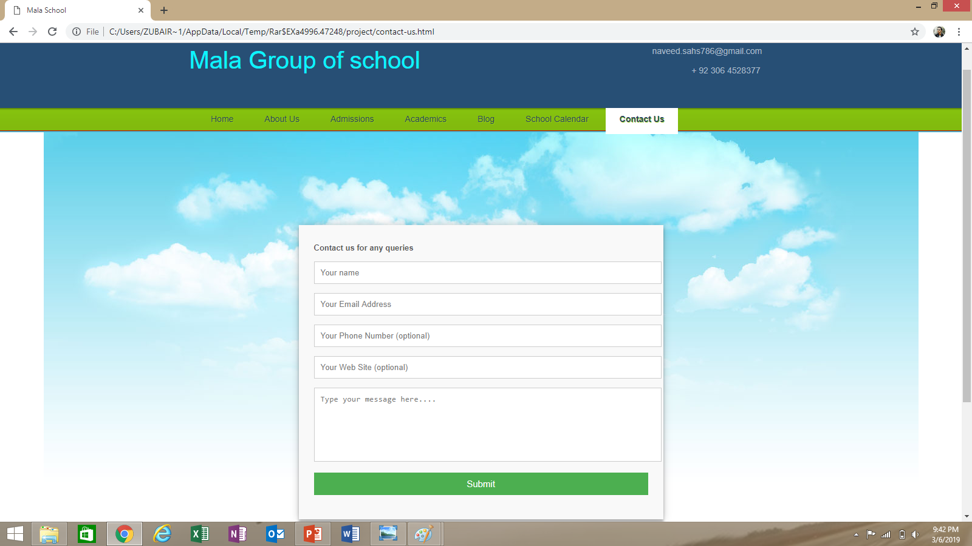
Contact us
New User can asked and Tell about everything on website.
Name
E-mail
Phone Number
Web Site(optional)
Type Message and comments
Submit your information

Slide 12
THANK YOU

